Slide 1

Relief Fund dApp
A Decentralized Solution for Secure Disaster Relief Funding

Slide 2
Problem Statement
Lack of Transparency
Centralized Vulnerabilities

Slide 3
Proposed Solution
Decentralized Application can make this transparent fund distribution possible.
Users can donate Ether to the fund.
Utilizing blockchain technology like Ethereum, will avoid centralized vulnerabilities like single point of failure and centralization.

Slide 4

Why Ethereum?
Run without centralized control
Cannot be taken down
Using smart contract there is no need of intermediaries

Slide 5
Smart Assets and Participants
Cryptocurrency (Ether)
Donors
Relief Fund dApp admin

Slide 6

Future Enhancements
Convert the dApp to support multiple instances using Clone Factory pattern
Upgrade to Layer 2 solution like Polygon
Implement multiple cryptocurrencies
Mobile Application

Slide 7

Conclusion
By leveraging blockchain technology with this application, it delivers funds faster, secure and more transparent than existing system

Slide 8
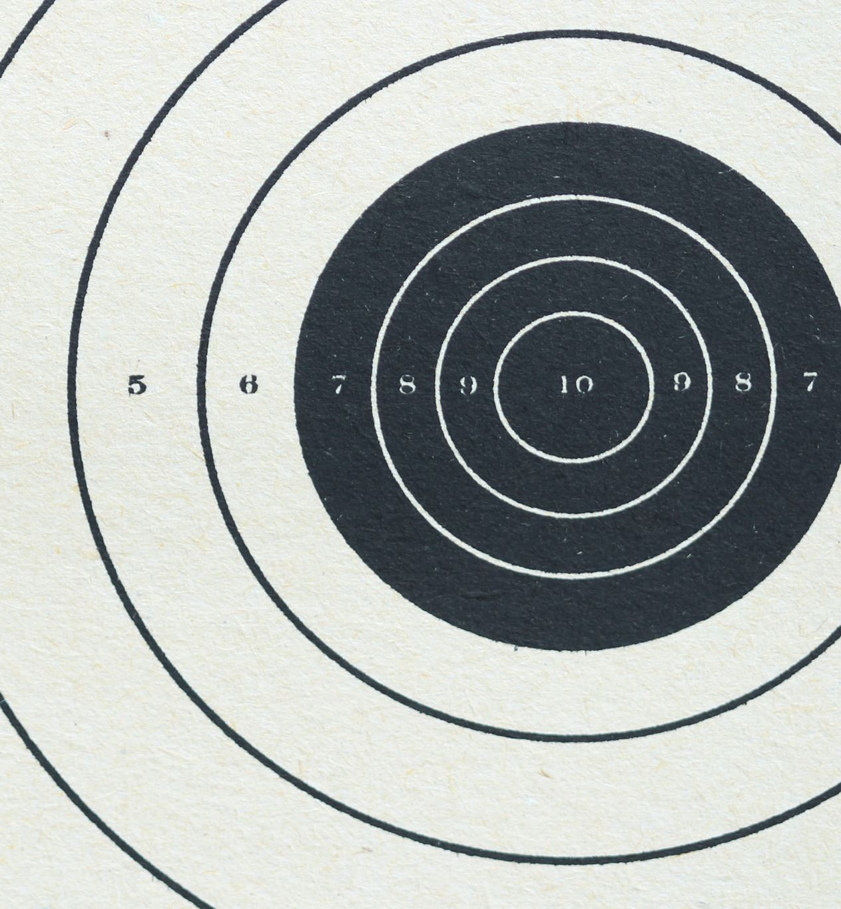
DEMO

Slide 9

THANK YOU!

